Slide 1
Online Retail
Ghadi Khalid

Slide 2
AIM OF PROJECT
Extract insights and provide it to decision-makers to improve company marketing and increase sales.
Showcase benefit of using a association rules to the company.

Slide 3
RESEARCH QUESTIONS
COUNTRY
QUANTITY
PROFIT
PRODUCTS
How many customers from different country , dose profit change?
How dose quantity trend change based on date?
How was the profit for this year based on months and days?
What is most sold products in the store?
I addressed more question in the report it’s written with bold font

Slide 4
DATA SOURCE
This analysis is on Online_Retail_II dataset provided by UCI
The dataset contain transactions occurring
for a UK-based and registered online shop
The store mainly sells unique all-occasion gift-ware

Slide 5
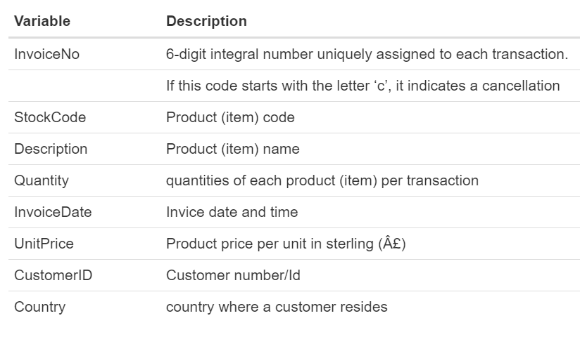
DATA COLUMNS

Slide 6
01
02
03
04
CLEAN DATA
EDA
INTERACTIVE VISUALIZATION
MARKET BASKET ANALYSIS
Remove NA ,Negative numbers and fix data structure
Explor data and analysis profit of store.
Provide interactive plot instead of dashboard
Provide most bought products
Notes:
The steps I took to find a solution for questions

Slide 7
CHALLENGE
01
Negative values NA values Wrong columns type
RESULT
CLEAN DATA
Change negative values to 0
Keep rows with NA values
Change column type

Slide 8
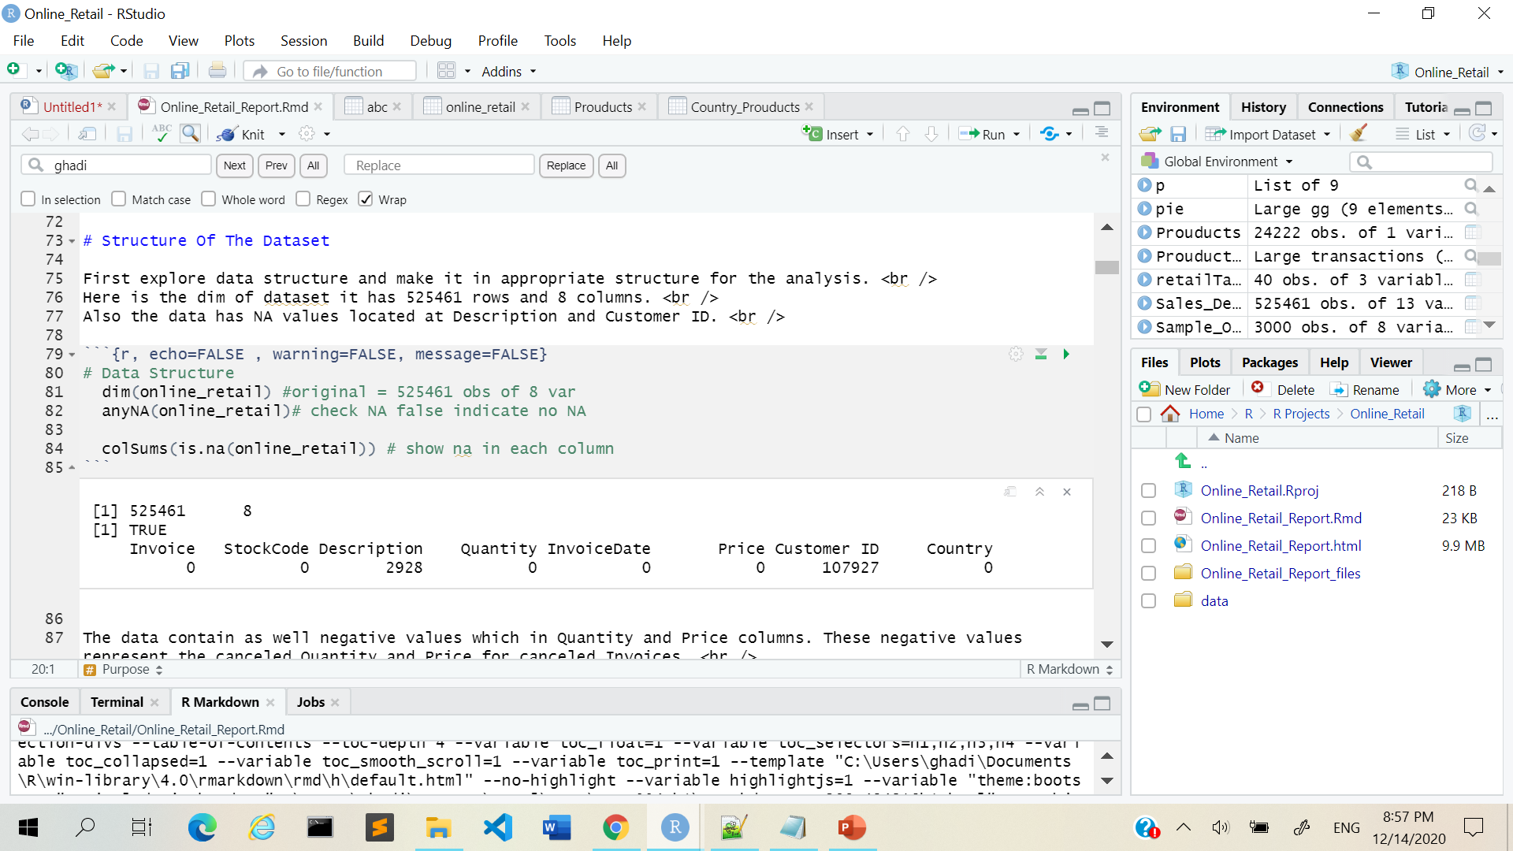
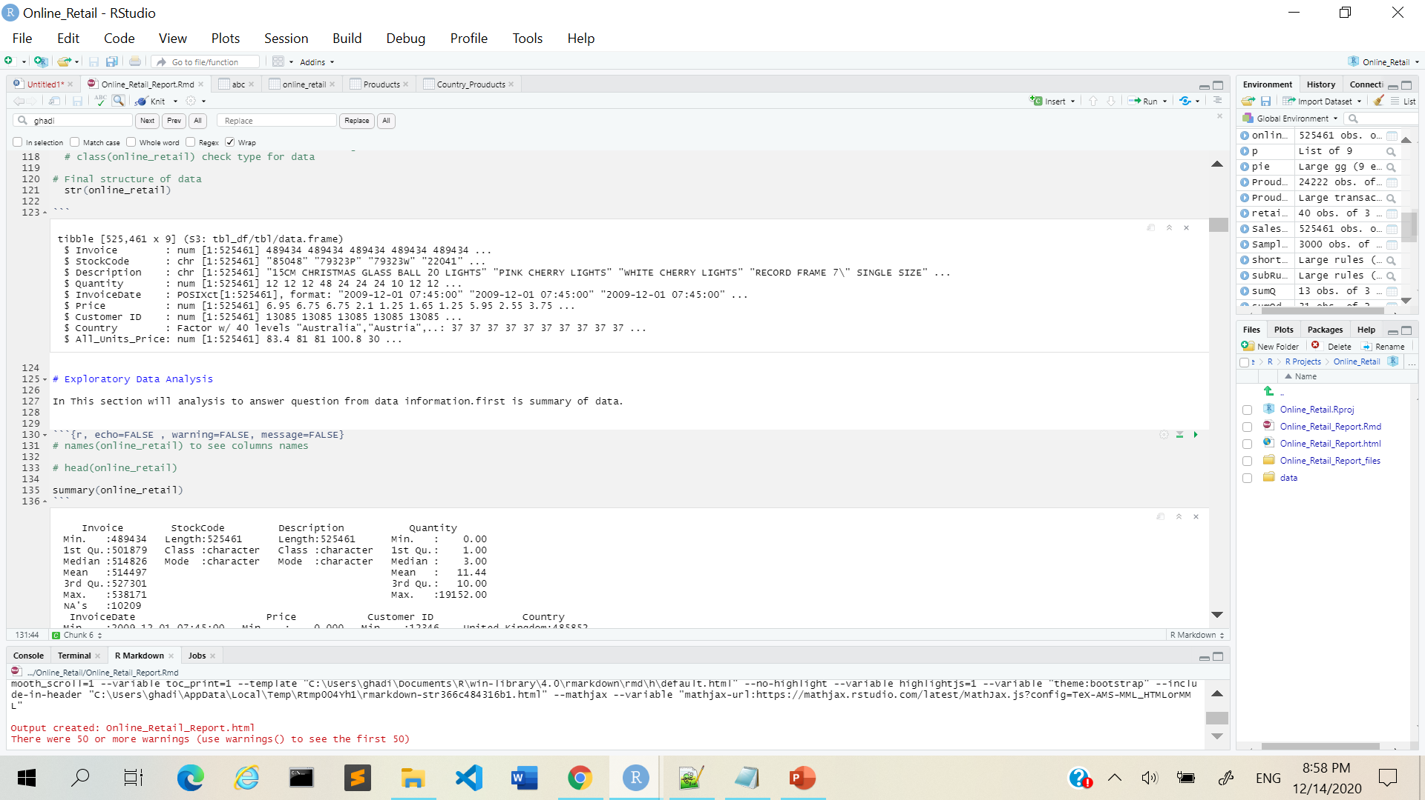
I tried to use impute to replace Description NA but failed

Slide 9
CHALLENGE
Dataset Size [525,461 rows] Combine Invoices
02
RESULT
EDA
Create sample to test code first
Create different variables grouped by Invoices

Slide 10
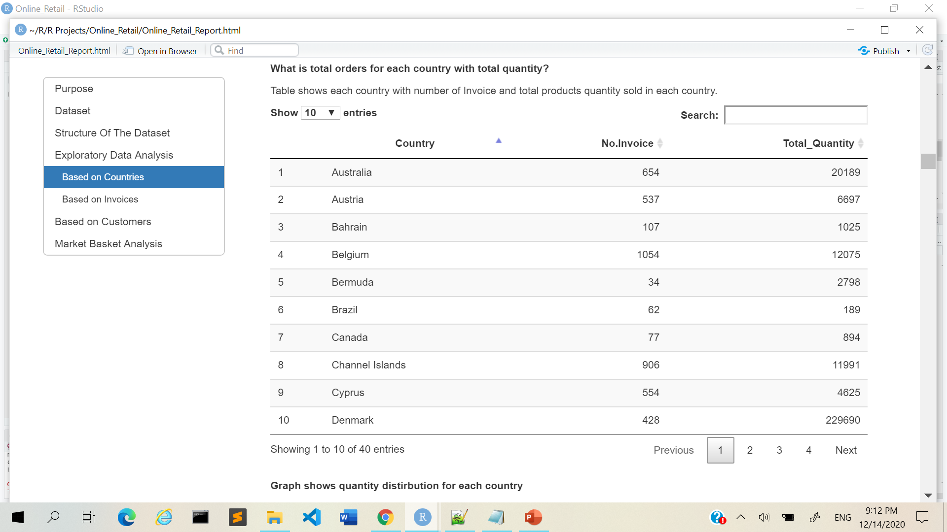
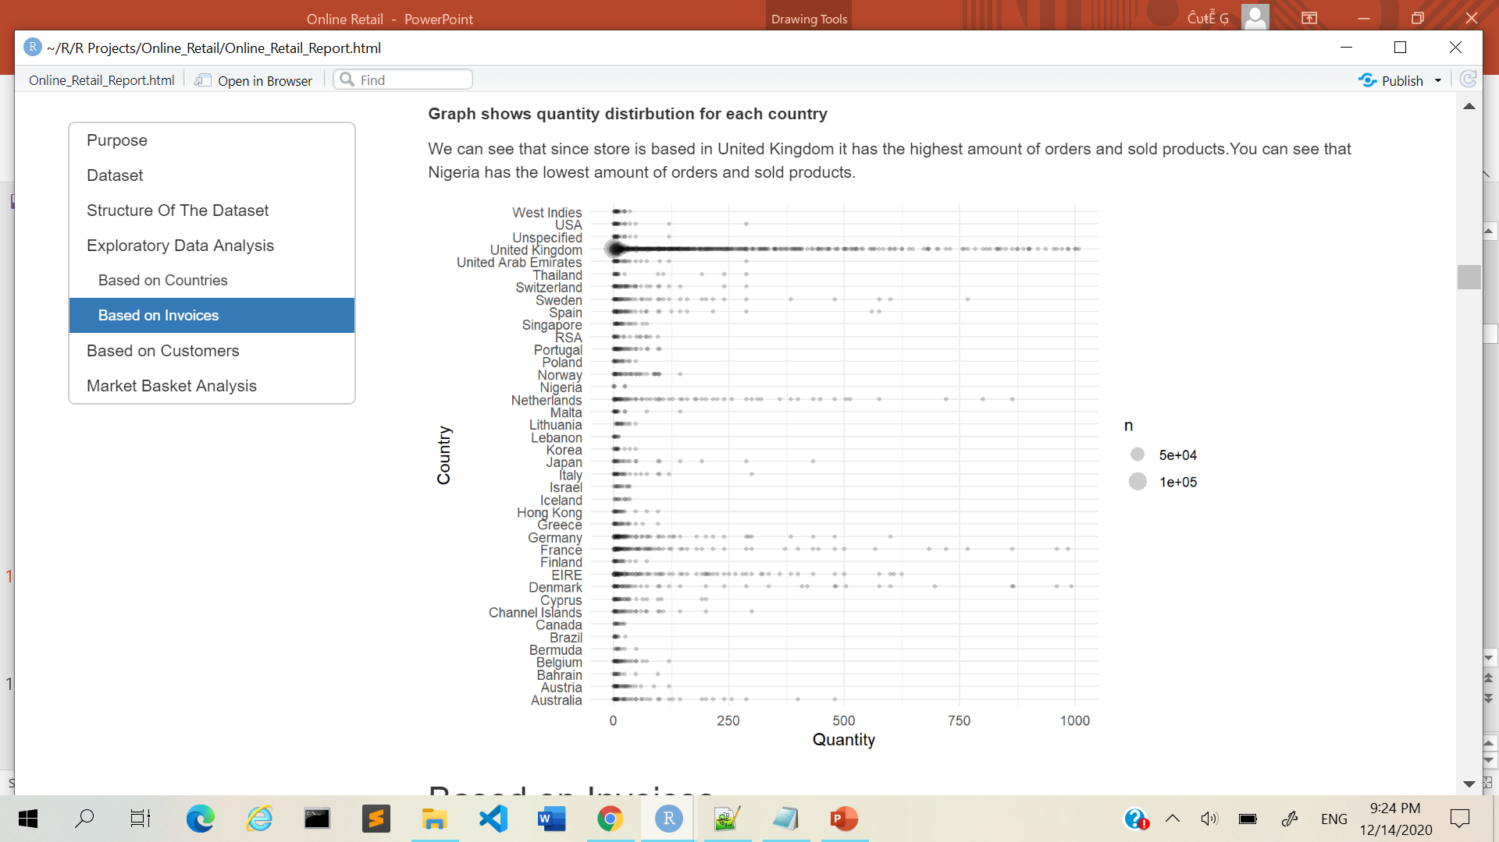
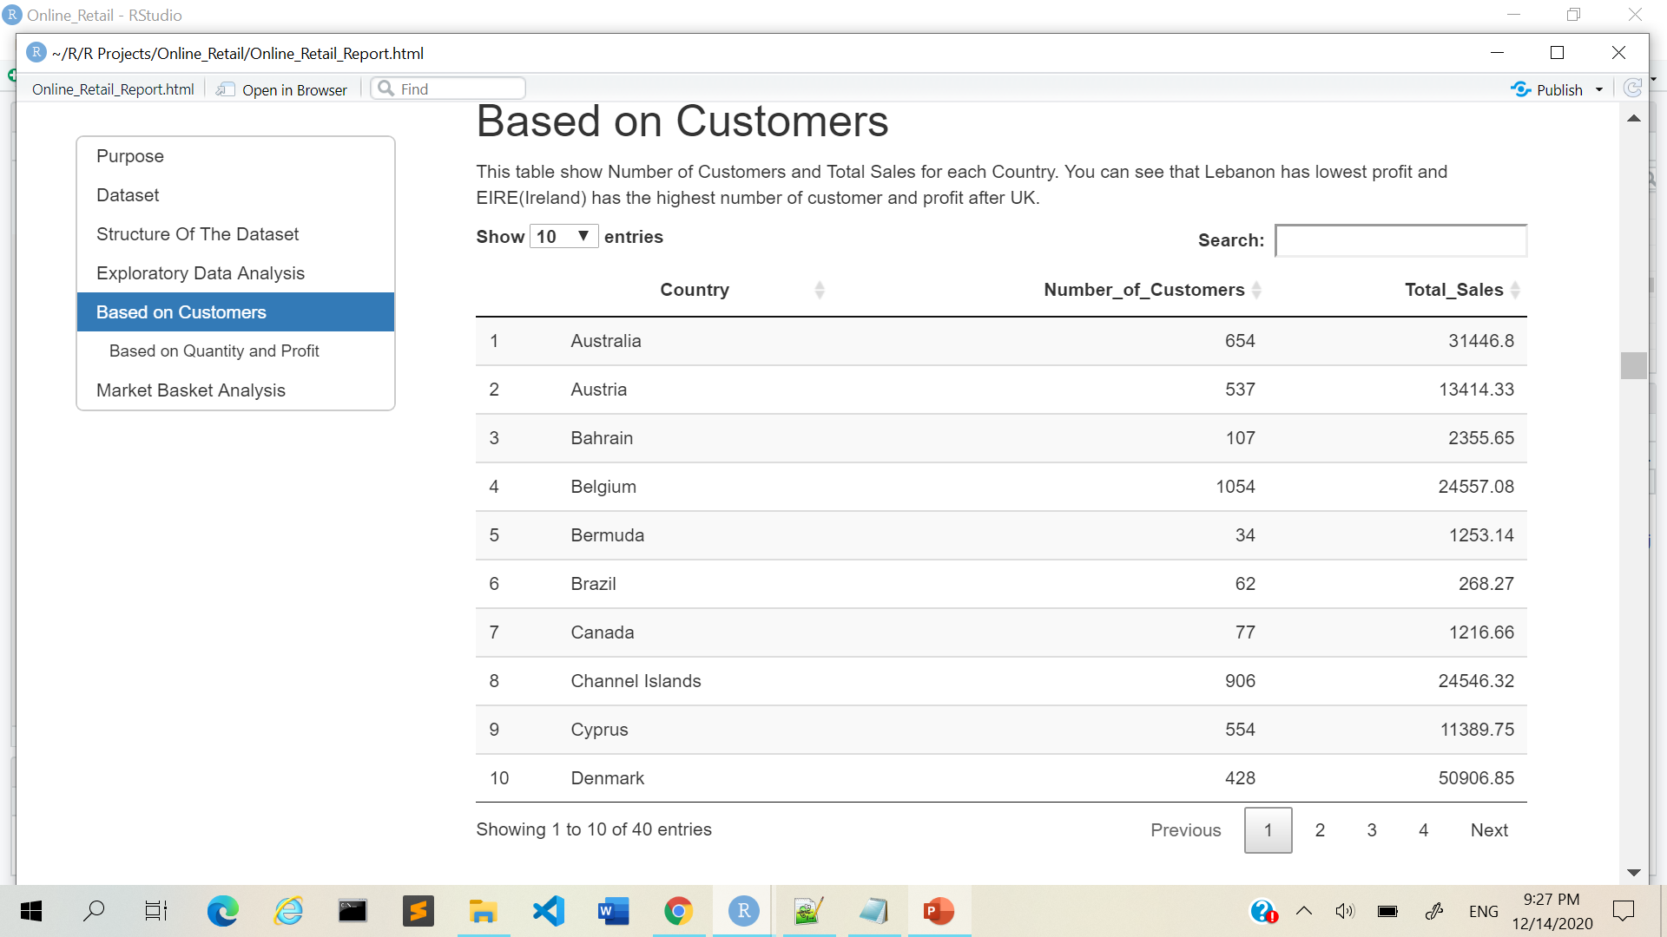
What is total orders for each country with total quantity?
What is total number of customers and total sales for each country?

Slide 11
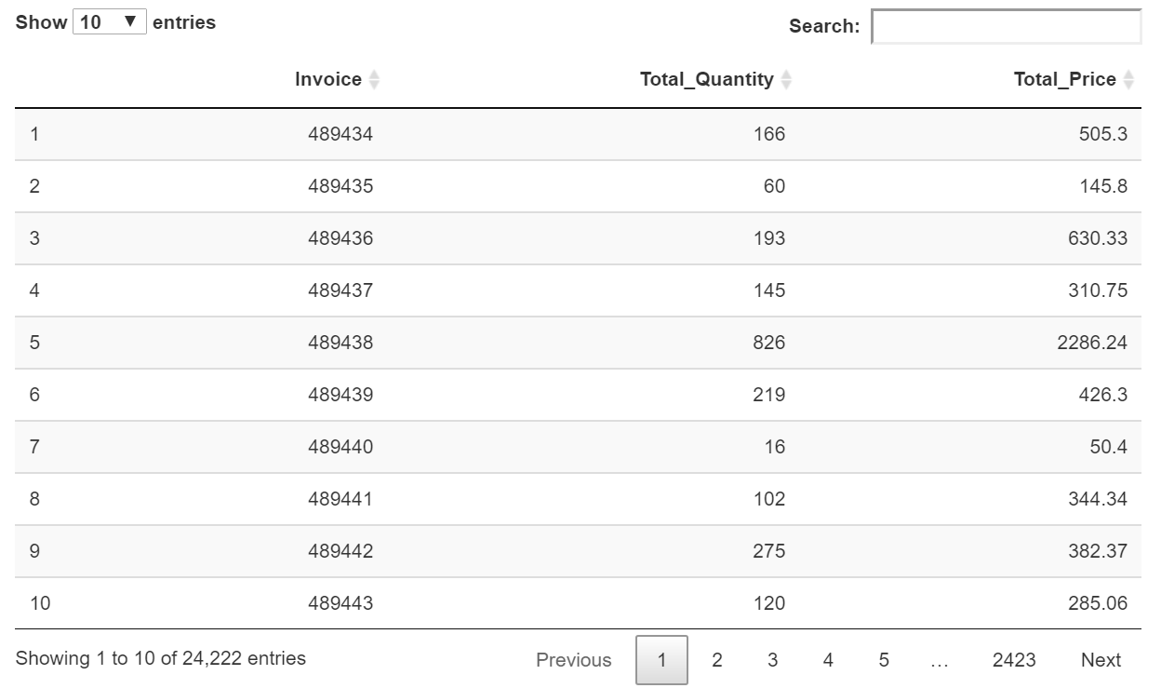
How many Invoices in data?
Here is each Invoices with it
total quantity and price

Slide 12
CHALLENGE
03
Dashboard Prepare data to plot Try different packages[highcharter]
RESULT
INTERACTIVE VISUALIZATION
Instead of Dashboard I used interactive plot packages & included it in report
Make different variables that I wanted to plot
Used plotly package

Slide 13
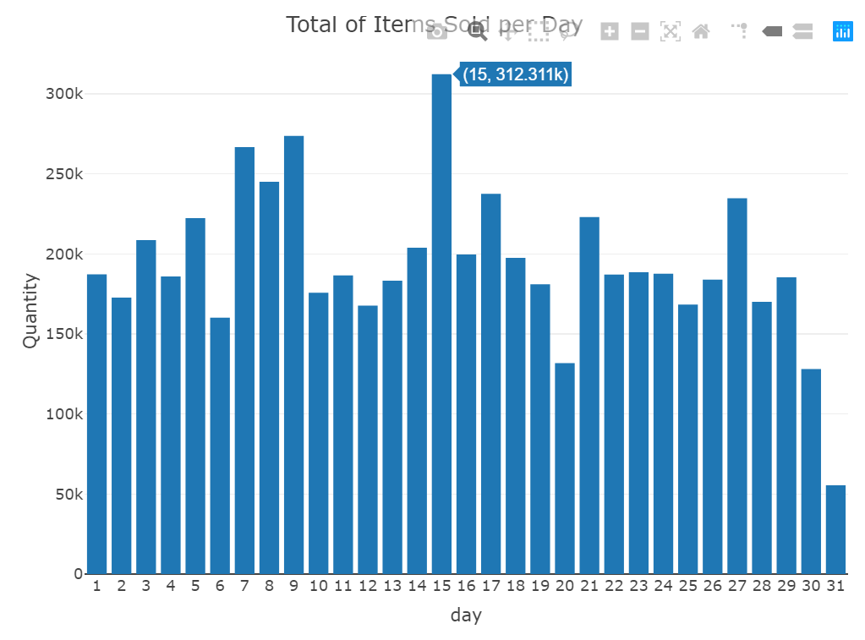
Total items sold per day?

Slide 14
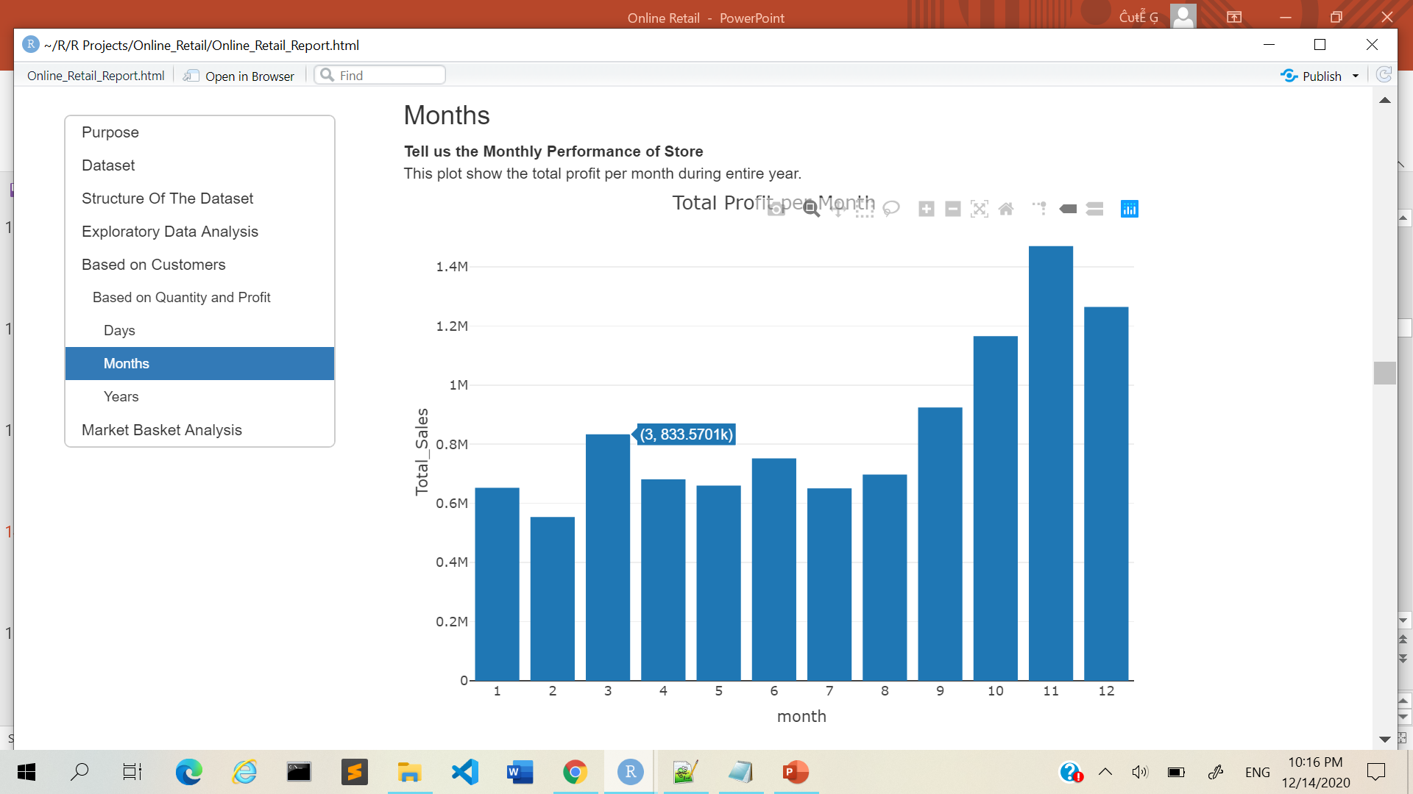
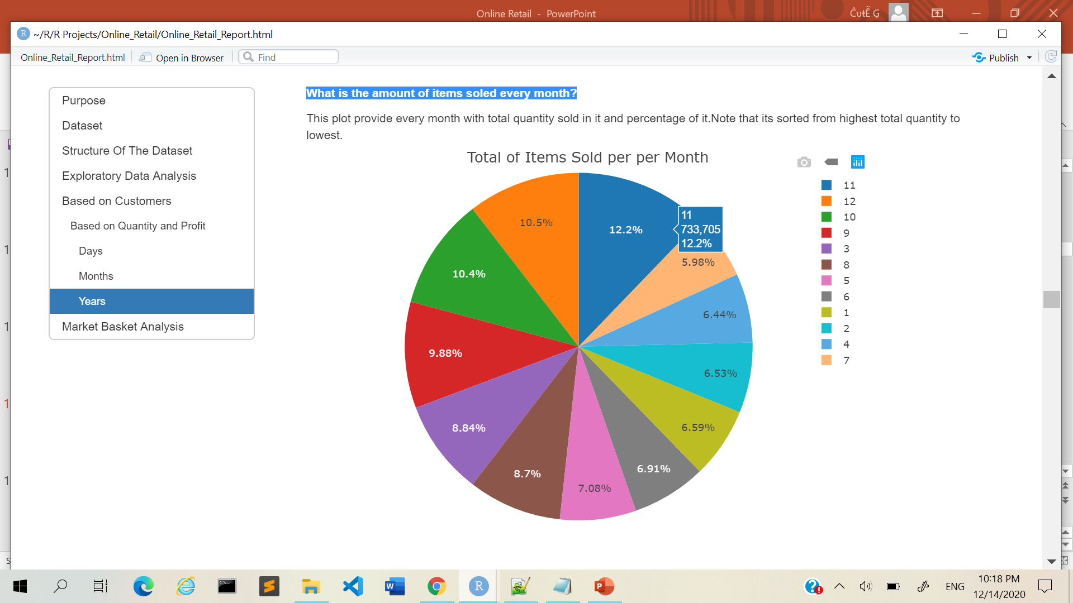
Monthly Performance of Store[Total Profit]
What is the amount of items soled every month?

Slide 15
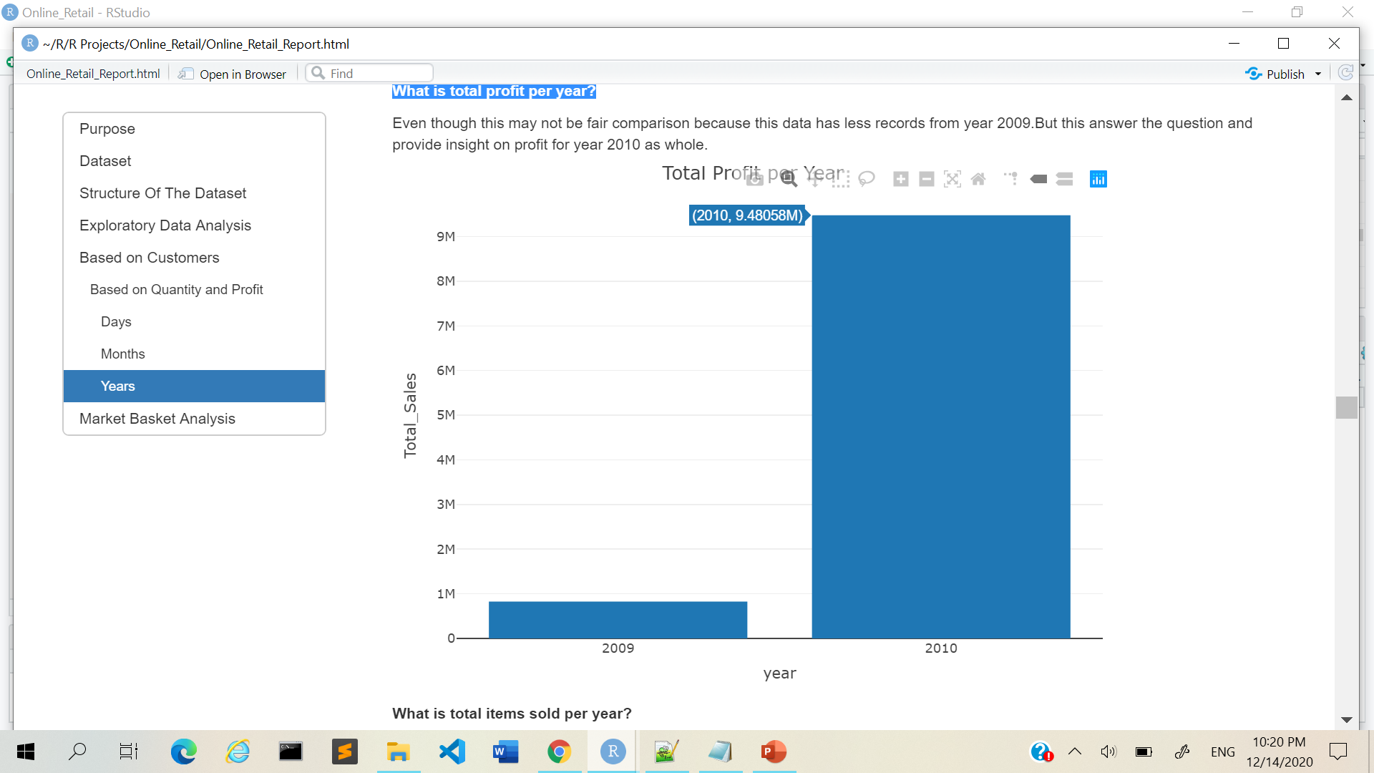
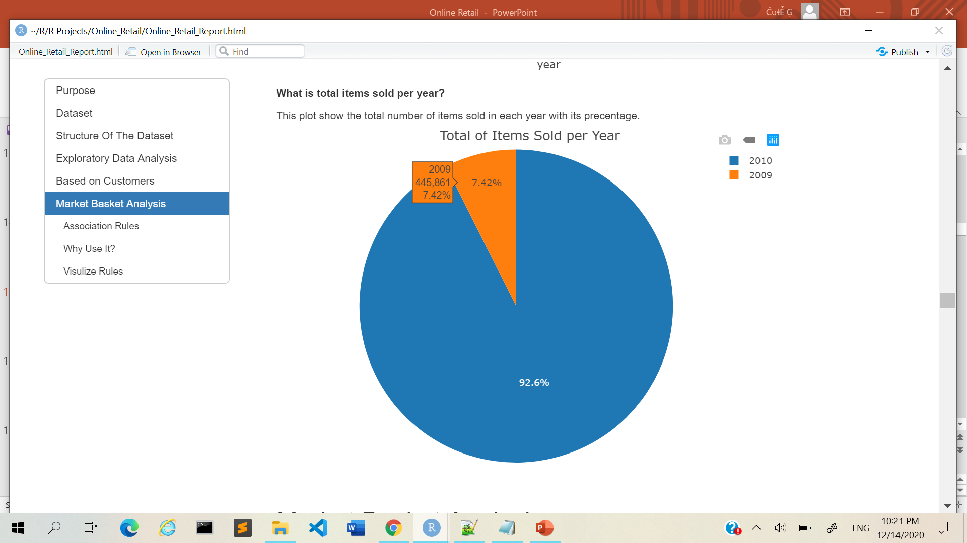
What is total profit per year?
What is total items sold per year?

Slide 16
CHALLENGE
04
Understand MBA Visualize results so that it’s easy to understand
RESULT
MARKET BASKET ANALYSIS
Extract popular products
Extract Association Rules
Change column type

Slide 17
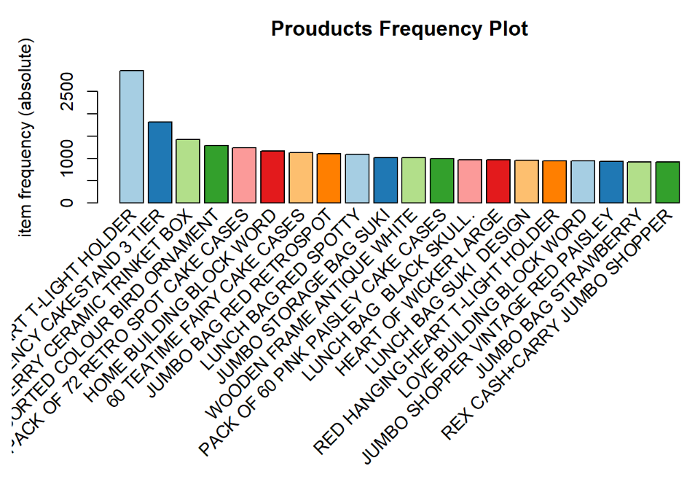
What is top 20 sold items in store?

Slide 18
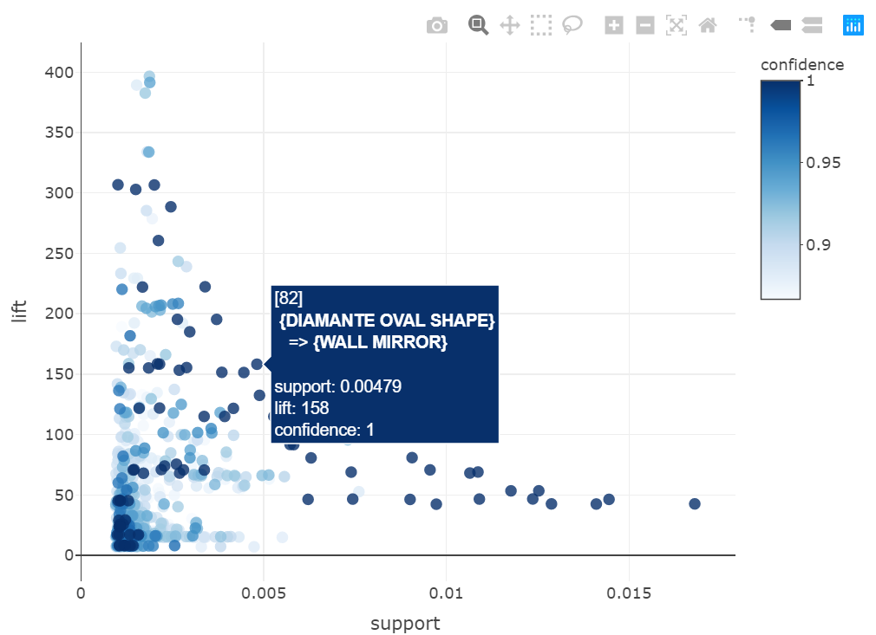
What is This best 1000 rules?

Slide 19
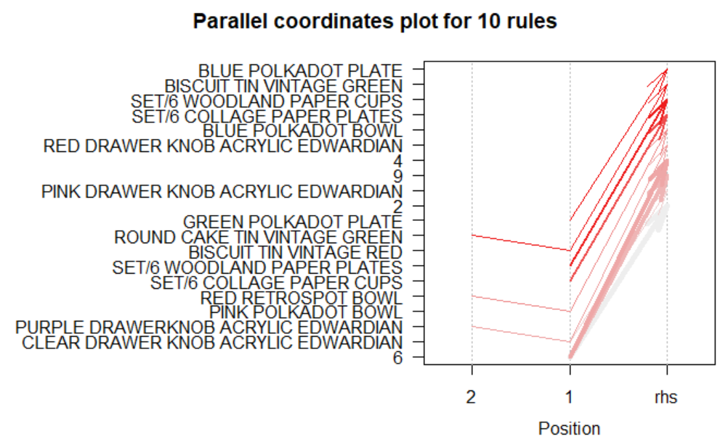
The darker the color the stronger the rule become.
ROUND CAKE TIN VINTAGE GREEN has rule with BISCUIT TIN VINTAGE GREEN.
o, who buy ROUND CAKE TIN VINTAGE GREEN will definitely buy ROUND CAKE TIN VINTAGE GREEN as well.
I Tried this but the result kept on change & have the number shown
So it’s fail

Slide 20
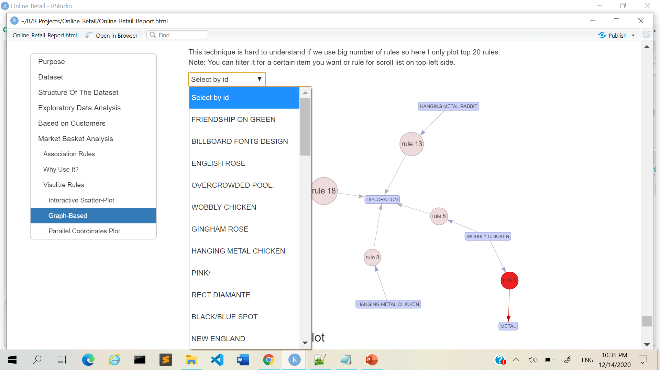
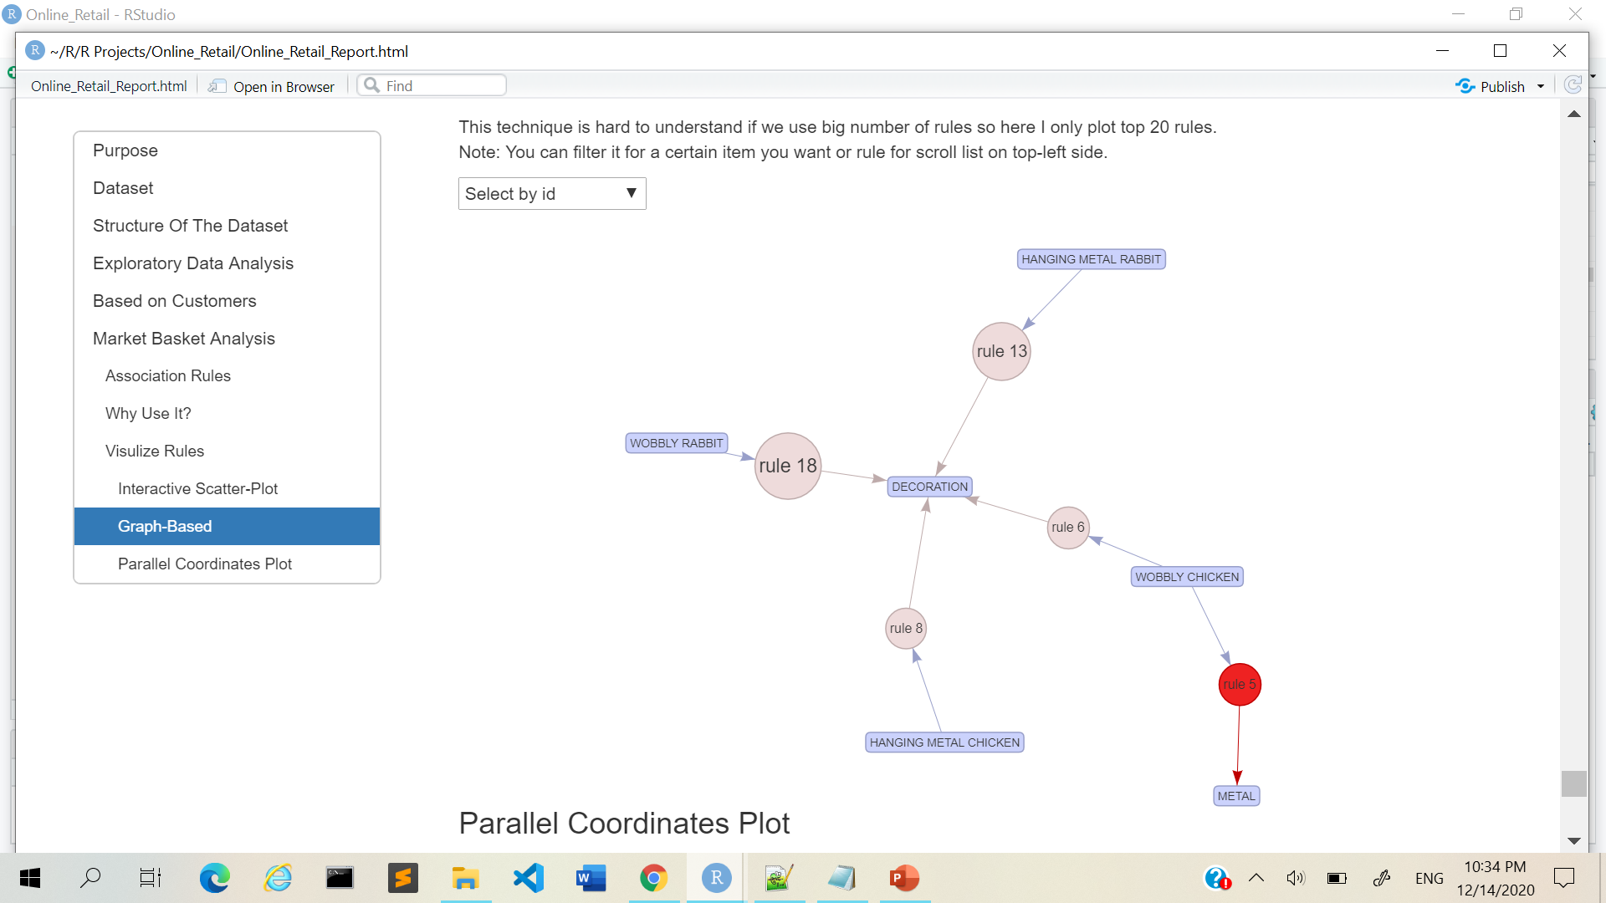
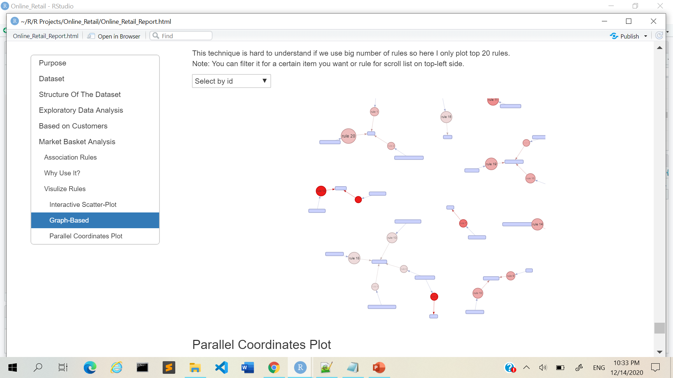
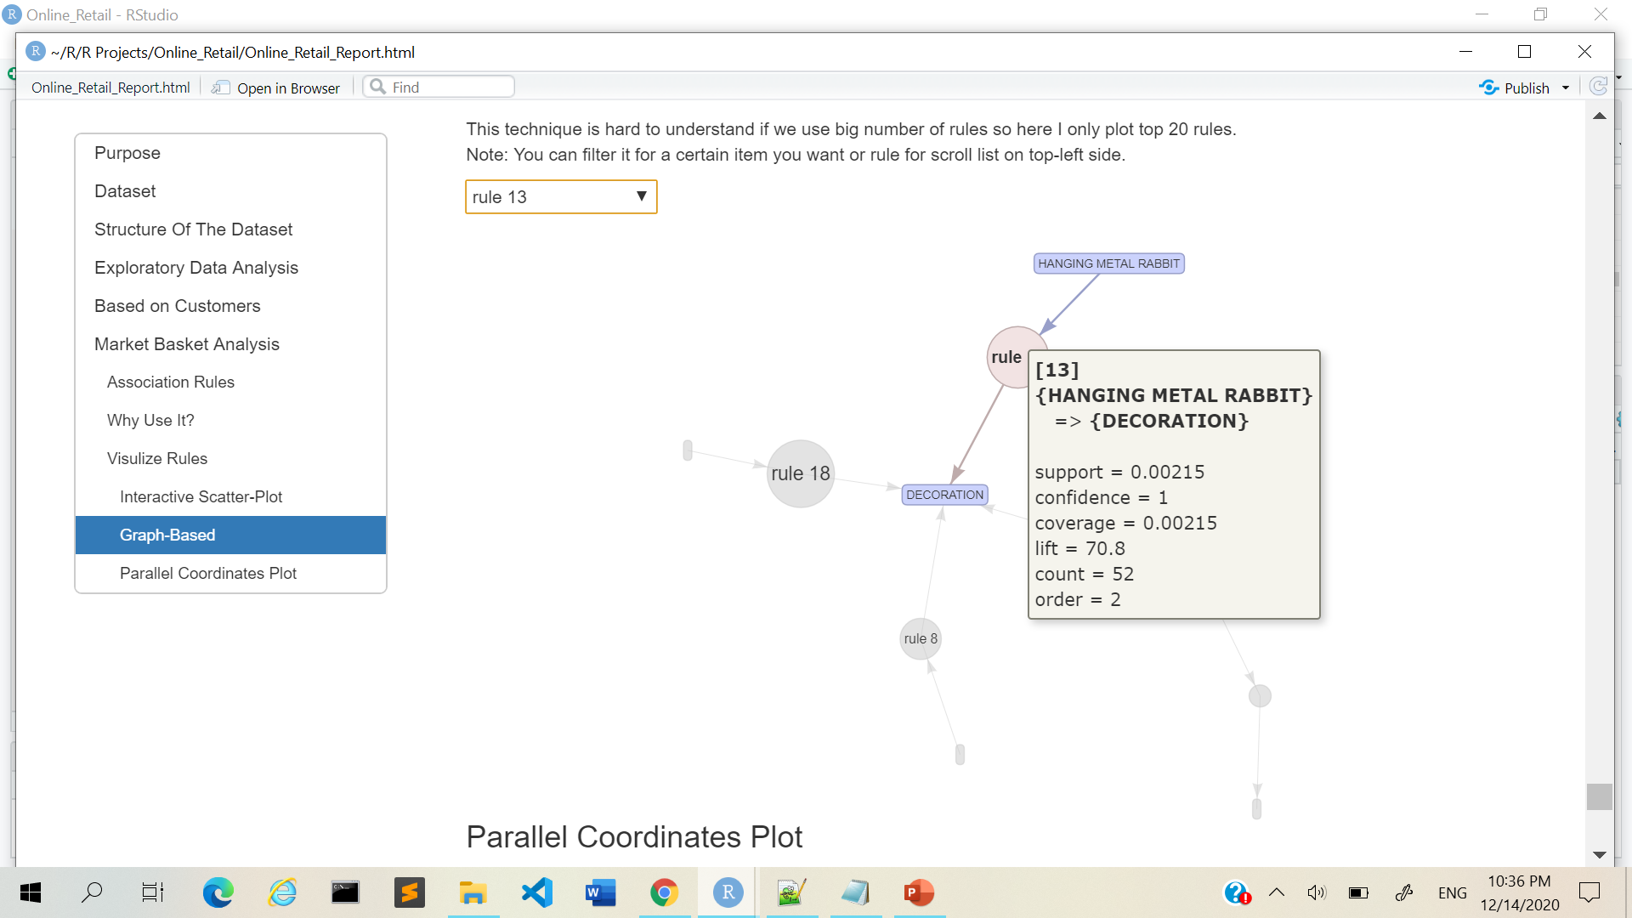
Showcase top 20 rules extracted from data?
Show all rule details

Slide 21
CONCLUSION
This report is to provide an explanation for small/medium companies for why & how can data analysis help provide insights to benefit the business.

Slide 22
FUTURE DEVELOPMENT
Customer Behavior Analysis
Save Interactive Plots
Recommendation Engine
Create website to showcase the association rules for products

Slide 23
APPLICABILITY
This analysis can be done on
any store transaction

Slide 24
THANK YOU

